Slide 1



Final Project
Levi Overstreet
University of Advancing Technology: NTW216

Slide 2
New Data Center Implementation Proposal
As the company continues to expand its business, the need for more data security and the ability to grow the digital footprint with that expansion will be ever-present.
Management has requested that the IT department plan a network layout for the new western region data center that will cover the needs for security and expansion.

Slide 3
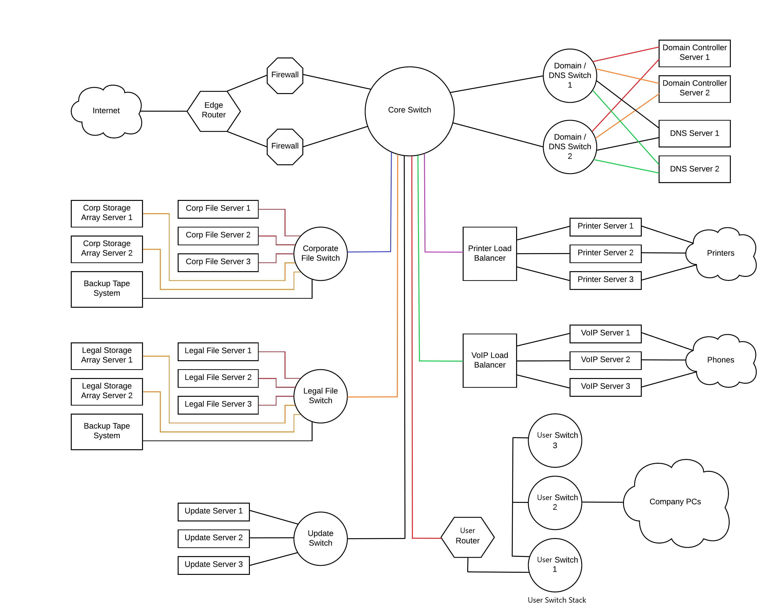
Network Diagram
High Availability
Redundant Servers
Built in Failover of key systems
Figure 1. Proposed Network Diagram

Slide 4
OS Selection
Web Services, DNS, & DHCP
Helps centralized management of all internet-based features for any given enterprise.
Domain Services
Active Directory Domain Service allows admins to manage users and computers on a network while giving them the ability to organize the data into logical hierarchies.
Software Update Services
Management of software updates with built-in group policy rules under Windows Server Update Services.
File Services
File Server Resource Manager helps admins manage stored data in file servers on the network.
Microsoft Server 2019 is the OS of choice for all servers in the network.
The reason for this selection is due primarily to its complete selection of suites and services that support our organization’s end goals.
Here are a few services that Server 2019 provides.

Slide 5
Ordering Equipment
Storage Array Servers built with 24 drives each in RAID 6 and redundant power supplies.
Backup Tape Systems are ordered as is.
Load Balancers can be either hardware based or software based on server platform. If server, built with RAID 1 and redundant power supplies.
Print Servers built with RAID 1 configuration and redundant power supplies.
VoIP Servers built with RAID 1 configuration and redundant power supplies.
Update Servers built with RAID 1 configuration and redundant power supplies.
All networking and server equipment is new and all servers are built to spec from the distributor.
Domain Servers built with RAID 6 configuration and redundant power supplies.
DNS Servers built with Raid 5 configuration and redundant power supplies.
File Servers built with RAID 6 configuration and redundant power supplies.

Slide 6
Domain Controller
Active Directory Domain Service allows admins to manage users, computers, and servers on a network.
The Domain Controller Servers are built to be redundant and will operate in a Failover manor.
Key functionality of AD DS
Users and Computers
Administration Center
Domains and Trusts
Sites and Services
Security Policy Enforcement

Slide 7
DNS Servers
The DNS servers will handle the majority of the web services for the network.
The servers are built to be redundant and will operate in a Failover manor.
Key Web Services
DNS
DHCP
HTTPS
FTPS

Slide 8
File Servers
There are two separate File Server Clusters to help support the separation and organization of data for the company as a whole as well as all legal matters.
All the servers are built to be redundant and will operate in a Failover manor.
We will be running multiple storage array servers connected to expand the amount of stored data.
We will also have Backup Tape systems connected to off load older data for long term off site storage.

Slide 9
Update Servers
The Update Servers will handle the downloading of updates as well as pushing those updates out across the network.
The Update Servers are built to be redundant and will operate in a Failover manor.

Slide 10
Print Server
The Print Servers will store and queue print requests for the network and send them to the printers to avoid overloading them.
The Print Servers are built to be redundant and will operate in a Failover manor.
The Print Servers are connected to a Load Balancer to help distribute incoming traffic to the servers.

Slide 11
VoIP Servers
The VoIP Servers handle data processing and incoming requests for the clients on the phone system in the network.
The VoIP Servers are built to be redundant and will operate in a Failover manor.
The VoIP Servers are connected to a Load Balancer to help distribute incoming traffic to the servers.

Slide 12
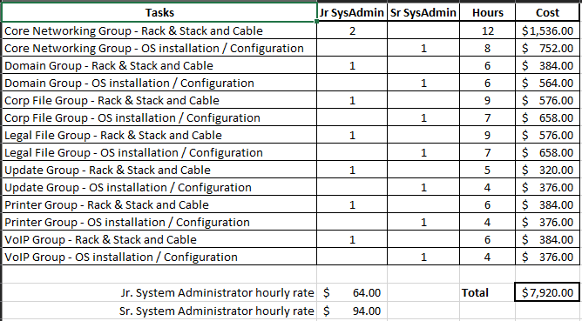
Time & Cost
This is a minimal estimate of time and cost and the time to completion and cost for completion will be different depending on the number of people assigned to the project.
Figure 2. Cost Break Down

Slide 13
References
Figure 1. Proposed Network Diagram [screen capture]. (2020).
Figure 2. Cost Break Down [screen capture]. (2020).

